Slide 1
Topic 0
Class Introduction
資料結構與程式設計
Data Structure and Programming
09/16/2015

Slide 2
Class Information
Class Website
  https://ceiba.ntu.edu.tw/1041_DSnP
Discussion board
  FB → NTU_DSnP
  To get in, (1) go to FB/NTU_DSnP to apply, and (2) go to https://goo.gl/Ua8k82 to leave your name
My office:
  EE building II - 444
  (Tel) 3366-3644
  (e-mail) cyhuang@ntu.edu.tw
  Office hour: stop by or by e-mail appointment
Class TA(s)
  TBD

Slide 3
Class Information
Required textbook: none
Suggested reading
  Class slides and source codes
    Download from the Ceiba website
  Any of your Data Structure and C++ programming textbooks
Highly recommended (DO THEM ASAP)
  Review C++
  Get access to and familiar with Linux workstations

Slide 4
Grading (May subject to change)
Homework 70%
Final project 30%
Bonus TBD
The final grades are subject to linear adjustment. Instructor will determine the average and standard deviation

Slide 5
授權碼
本課程這學期改為二類加選，並且不開放初選
欲修習本課程者，請在 09/22 (二) 9pm 之前，繳交作業一，授課老師在批閱過後會以 e-mail 寄出授權碼。
作業一題目載點：https://goo.gl/Do9Flp
[Note] 我們有強大的抓抄襲程式，會在事後檢查是否有抄襲的現象，請勿以身試法，會有嚴重的後果。

Slide 6
修課人數限制
教室容量
教學/助教 loading
學生的 commitment
  去年加退選完後仍有 210人，但期中過後停修人數達 47 人
  22.4%, 跟以往差不多(但稍高)，不過還是希望這些人能夠及早認清自己無法負荷這門課的現實
解決辦法
  訂定修課人數上限？
  先做作業一，讓同學們體驗/回憶一下寫程式的樂(ㄊㄨㄥˋ)趣(ㄎㄨˇ)

Slide 7
What HW#1 tells you…
C++ 很煩!! 為什麼不直接學簡單又漂亮的 Python, 或者是很潮的 Javascript 呢？
  身為工程學系的學生，我們除了要能夠很快的把事情做好之外，還要有把東西 optimize 10X 以上的能力
  不過現實是，看看你們 HW#1 的 code, 可以想像如果讓它再長大十倍、百倍、千倍… 會變成什麼樣子嗎？

Slide 8
關於資料結構與程式設計，這門課想要傳遞的觀念是…
語言的嚴謹性
  電腦語言 vs. 人類語言

Slide 9
bool operator() (const Data& d1, const Data& d2) {
return cmp(d1, d2, 0); }
bool cmp(const Data& d1, const Data& d2, size_t i) {
if ( d1[_sortOrder[i]] < d2[_sortOrder[i]] ) { return 1; }
else if ( d1[_sortOrder[i]] == d2[_sortOrder[i]] ) {
if(i < _sortOrder.size()-1 ) {
i++; cmp(d1, d2, i);
} else {
if(d1[_sortOrder[i]] < d2[_sortOrder[i]]) return 1;
else return 0;
}
}
else return 0;
}
-------------------------------------------------------------
bool operator() (const Data& d1, const Data& d2){
for (int i=0; i < _sortOrder.size(); i++){
int idx = _sortOrder[i];
if (d1[idx] != d2[idx]) return (d1[idx] < d2[idx]);
}
return false;
}

Slide 10
關於資料結構與程式設計，這門課想要傳遞的觀念是…
語言的嚴謹性
  電腦語言 vs. 人類語言
程式的架構需要設計
  你寫的程式除了要讓電腦看得懂之外，讓人類(尤其是自己)看得懂更是重要
資料結構的重要性
  試想你有一堆等待被運算或是分析的資料，如何確定某筆資料存在？如何確認所有資料被運算過一次？如何有效率的增加或是刪除資料？
資料 vs. 物件, 結構 vs. 類別
  希望大家可以將「資料結構」與「程式設計」融會貫通

Slide 11
練習
知識
觀念
習慣
耐心、細心

Slide 12
為什麼是 C++? 為什麼不直接學 Web/APP 就好?
寫程式需要的三種能力
  熟習文法：不同的語言，其實文法都差不多
  建立觀念、培養直覺：Write the code right!
  數理邏輯觀念：非單從寫程式中去培養
大部分的網路程式、APP 等等，入門的技術門檻其實都不高，但要寫得快又好，而且能夠 “長大”，需要的就是良好的寫程式的 “sense”、“concept”，以及“習慣”，還有正確的 “optimization” 的概念，這些都必須從比較低階、複雜的語言 (即 C++) 來學，才會學得透徹

Slide 13
為什麼是 C++? 為什麼不直接學 Web/APP 就好?
我們有許多優秀的 CS 人才，但卻沒有一個像樣的 CS 產業，WHY?
PC 時代，“軟體” 為主要獲利之 “商品”
  我們靠生產 Intel CPU 周邊的 IC 與零組件成就了 ‘95 ~ ‘05 的高科技奇蹟 (硬體出口產業)
後 PC 時代，”廣告“、”服務” 為主要的獲利方式
  Yahoo, Google, Amazon, e-Bay, FaceBook 的崛起，我們的定位在哪裡?
  台灣市場太小，其實是很嚴重的問題
  「廣告」、「服務」可以外銷嗎？
  APP 是個產業嗎?

Slide 14
「把 C++ 學好之後，再去學其它語言相對的會很容易」…
Yes, 大部份電腦語言的語法、架構，都很相近
即使是不同的地方，如果你從語言設計的觀念上去了解為什麼要這樣，你就可以很容易的融會貫通
希望你從這門課學到的對於「程式語言」的觀念與態度，可以延續到你以後對於其他程式語言的學習

Slide 15
聽說這門課很操，是真的嗎?
不要懷疑，根據多次的問卷統計，同學們覺得這門課的 loading 大約 >= 9 學分，每兩個星期要花 20 ~ 30 hours (以上) 在作業上。
因為我覺得台大的學生根本修太多主科了!!
你可以去修很多其他領域的課，跨領域學習，
增廣見聞；
但你如果想要把一些專業科目學好，我覺得一學期應該修兩三門就好，然後每門課九學分 (誤)!

Slide 16

Before I get into detail course introduction, let me clearly state some principles and expectations so that you can decide whether you want to stay or go.

Slide 17
雖然這門課很操…
但好處是沒有期中 & 期末考，不用去 K 教科書或是消習題。
  不過有期末 project
  而且要學會自己找參考資料
所以如果你還要忙社團或是要參加什麼隊的，或是其他的課很重，請搞清楚你的 availability，切莫始亂終棄!!
我的目標是：同學們在修了這門課之後除了對於資料結構能有正確的觀念之外，起碼要有自行 handle 1000 行程式碼的信心!

Slide 18
寫 1000 行程式，很難嗎？
當然，要看是寫什麼
如果是有功能性，可以解決一些問題的程式，1000 行的程式的確已經有相當的複雜度
重點是 --- structured design and thinking!
人腦的思考複雜度有一定的限制，如果有超過一定數量的元素要一起考量， 就會無法掌握
但階層式的、歸納式、模組化的思考，有助於化繁為簡，讓程式在可以 handle 的範圍內被最佳化

Slide 19
寫 1000 行程式，很難嗎？
10+ 行的程式
→ 課本的作業，練習語法，no brainer
100+ 行的程式
→ 熟悉語法之後，並持著一股浩然正氣的意念用力寫下去，大家都做得到
1000+ 行的程式
→ 如果有能力將 100+ 行的程式模組化，那 1000+ 行的程式要 handle 的只是最上層的 control flow, 何難之有？
10000+ 行的程式
→ s/1000/10000, s/100/1000, repeat this!
Notes:
10+ ➔ 重複練習沒有意義，會把題目熟練到從 3 分鐘 → 30 sec, 但卻沒有能力花 3 分鐘好好的把一件事情論述清楚

Slide 20
我是個寫程式的小嫩咖，我有辦法修這門課嗎?
原則上絕大部分的人在你們這個年紀都是寫程式的小嫩咖，所以我想沒有問題。
重點還是要能有每兩個星期交一個作業，連續14 周，然後再加上一個期末專題的 “commitment”
  再強調一次，要考量現實，不要輕易相信自己的意志力可以戰勝一切!
Commitment 從何而來?
  首先，請確定 “把程式學好” 對你的重要性
  再來，請確定自己可以接受 “學習比成績重要”
  還有，請發誓自己 “寧願被當，也不會抄襲”

Slide 21
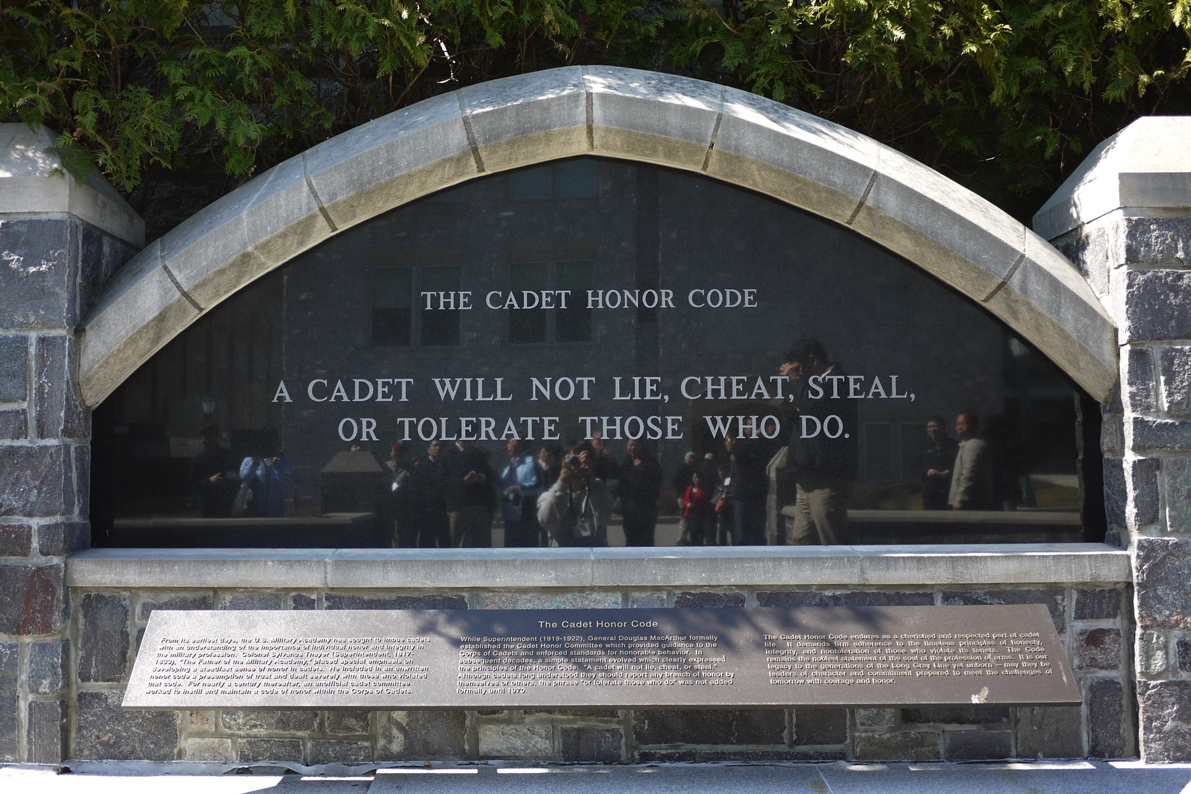
DSnP Honor Code

Slide 22
DSnP Honor Code
上課要專心，寧願翹課也不要來課堂做別的事
作業不抄襲，寧願被當也要從頭到尾自己寫

Slide 23
DSnP Honor Code
上課要專心，寧願翹課也不要來課堂做別的事
  不點名，學生有自行決定如何學習的自由
  但是如果你是來教室上臉書、打電動、睡覺補眠，那對我是種不尊重，對同學也有不好的影響。
  如果你覺得上課的內容你都已經會了，就請不要貪圖這個學分，把座位讓給別人，或者，你也可以不用來上課。
  不過，上課用電腦寫寫小程式，驗證上課所學，或者是上網查詢相關資料，是 OK 的

Slide 24
DSnP Honor Code --- 關於抄襲
Definition: 所謂「抄襲」，就是將別人部分或是所有的 code, 用 copy/paste, 或是看著 code 跟著打的方式，變成自己的作業的一部份
  歡迎互相討論，甚至拿別人的 code 來 study 也不會/無法禁止 (雖然這樣並不好)，但最後一定要自己獨立的寫。
我們有強大的抓抄襲的程式，會對所有的作業以及之前學長姊的作業去做比對，如果沒有抄襲，相似度都會很低，但如果有抄襲，不管你是改變數名稱， 還是換 statements 順序... 等等，我們都可以很容易抓出來，所以請勿抱著苟且的想法。
  以我們的作業複雜度而言，只要是自己寫的，一定一眼就可以看出跟抄襲的不同。
凡抄襲者不論多寡、理由，除該次作業 0 分之外，學期成績一律再扣 20 分 (調分後)

Slide 25
一些前車之鑑…
老師您好:
對不起老師...我對之前的作業有些抄襲or參考的疑慮，睡覺都睡不好，
所以還是先寄信詢問(自首)了...雖然我自認程度很輕微拉(爬過ptt對於抄襲的定義，覺得還好??)
自從在寫HW4快到尾聲時在網路上搜到疑似老師2012年DSnP的解答...相信老師都知道，因為實在太好搜了= =
之後我作業不懂的就會去看老師的code...
…

Slide 26
一些前車之鑑…
我覺得網路上那2012版的解答，雖然部分不夠完美(EX:HW6 gate定義覺得可以再刪減)，
但他對於我就像潘朵拉盒子，一載下來看，就是罪惡...可是當作業不懂時，他卻是最好的來源。
……
如果真的被處罰也很甘願，因為是我自己程式能力不足。
儘管如此...還是拜託老師開恩...即使有2012年的code，我每次作業也是會花20小時up，覺得努力沒有比別人少...
也常常跟同學討論code，當然都是based on對老師code的理解，再加上自己的詮釋。
最後，謝謝老師看完我很長的解釋文...感謝老師開DSnP，我學到的真的很多!!

Slide 27
一些前車之鑑…
(From Ric)
很遺憾的，你沒有在學期中我一再強調抄襲的定義的時候就主動承認，而前幾天問你的時候你也還是無法就直接承認你就是有抄襲。
因此，我只好按照學期初所說的規定，將你該次的作業算成零分，然後學期成績在調分後在扣 20 分，因此，你的成績將會變成 52分(F). 希望你可以接受這樣的處置。
----------------------------------------------------------------------
(Reply)
這次的經驗已經讓我飽嚐煎熬與苦頭
以後不只不敢再犯大概還會便成陰影警惕很久
這幾天也想了很多，那些文過飾非的話大概不只是想要粉飾太平，一部分也是因為內心本來就有所愧疚想要說服自己吧
正如教授所說：不只沒有遵守規定，我還欠缺更多勇於認錯承擔的態度
謝謝教授，還願意耗費時間跟我說這麼多。

Slide 28
有教無類? 教學品質?
Well, as you can see, the class was overbooked.

Slide 29
Should I stay or should I go?
After taking the class, somebody liked it, but somebody hated it.
去年 210 個選課的同學，最後 47 個停修，7 個被當掉
  // 當掉/停修/修課人數
  電機大二: 1/3/37
  電機大三: 2/29/117
  電機大四: 1/4/20
  外系 (物理、數學、心理、機械、化工、工科海洋、生機、資工): 1/7/28
  研究所 (電機、電子、生醫、物理、生機、資管、資工): 2/4/8

Slide 30
Some statistics about the grades
 | 103-1 | 102-1 | 101-1 | 100-1 | 99-1 | 98-1
外系 | 79 (21/27) | 76 (10/13) | 70 (3/4) | 80 (6/8) | 82 (5/7) | 61 (5/5)
電二 | 82 (33/37) | 86 (21/26) | 78 (36/38) | 83 (29/32) | 83 (27/27) | --- (0/1)
電三 | 82(86/117) | 81 (59/65) | 82 (80/89) | 79 (98/110) | 84 (101/106) | 88 (74/83)
電四 | 77 (15/20) | 78 (8/11) | 73 (7/8) | 82 (31/31) | 86 (17/22) | 82 (27/38)
資工 | 80 (1/1) | NA | NA | 92 (2/2) | 84 (7/11) | 87 (11/15)
研究所 | 62 (2/8) | 57 (4/7) | 86 (5/6) | 63 (1/2) | 52 (2/3) | 58 (3/3)
Notes:
有過/修課人數

Slide 31
Some statistics about the grades
Average: 80.7
A+: 48
A: 21
A-: 30
B+: 14
B: 13
B-: 11
C+: 5
C: 6
C-: 8
F: 7

Slide 32
“Should I stay or should I go?”
Please check on your own:
Do I have the eager to improve my programming skill?
  光有 “希望” 是不夠的，要有 “渴望” 才行。
Am I willing to spend more than 10 hours per week on the homework?
  獨力完成，不抄襲，也不要當寄生蟲。
Do I agree that “learning” is the most important thing in class?
  心態上要能接受 “學習” 比 “分數” 重要。

Slide 33
FAQs & Suggestions
Can I take this class as I am not an NTUEE student?
  You are also welcome, but you are advised to find someone to study and discuss together.
Can I sit in this class?
  Well, technically there is no restriction on sitting-in.
  However, since the number of students is way too high, please leave the seats to the students who take this class.
Is this the last time I offer this class?
  Nobody knows. But I will try to sign in this class as long as it is possible.
  Please note that other professors also offer this class in different semesters.
My only request to you: 做人要甘願!!
  If you decide to stay in this class, you need to know that this is a heavy class, and this is YOUR decision.
  Don’t blame on me if you find it too heavy-loaded!

Slide 34
歡喜修課，甘願承受
說實在的，DSnP 是 NTU(EE) 的奇蹟!
  需要大家共同的珍惜
非誠勿試，please!!

Slide 35
Course Outline
Part 1: Introduction
0. Class Introduction
Data Structure in Programming
  Why is data structure (implementation) so important?

Slide 36
1. Data Structure in Programming: Why is data structure (implementation) so important?
Why do you learn DS?
  When will you use it in your daily life, if you don’t apply it in your programs…?
“Programming is an art; DS is the spirit of the art.”
  If you know how to cleverly utilize DS in your codes, you will definitely produce an elegant program.
  Masterpiece? 99% perseverance and 1% talent
“Writing program is an ego thing,
while writing a SW tool/framework needs cooperation”

Slide 37
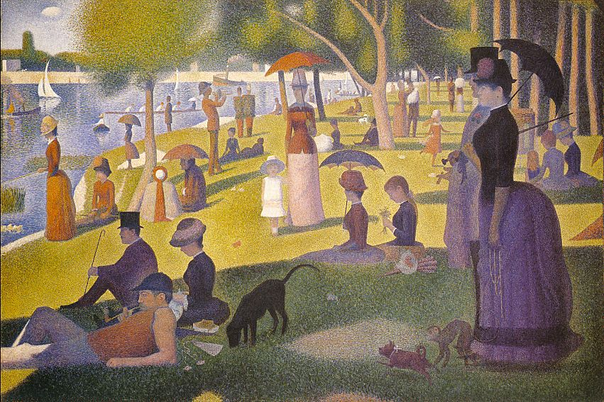
Georges Seurat, “A Sunday Afternoon on the Island of La Grande Jatte”, 1884-1886

Slide 38
Data Structure in Programming
As we will see, “programming” is nothing more than “storing” and “operating” data.
“Data structure”, in general, includes all types of “structured storage” in which data can be “operated” in various ways.
“Object oriented programming (OOP)” teaches you how to use “structured data type” (e.g. class) to write a good program.

Slide 39
How to be a good programmer?
My observation
  Achievements in ACM or programming contests do NOT necessarily imply good programming skill.
  It just means that you are smart, or at most, good in math and logic.
Our objective here is not just to be a good programmer, but a good program designer.
  Has the capability to plan, architect, and manage a large scaled program.

Slide 40
Course Outline
Part 1: Introduction
0. Class Introduction
Data Structure in Programming
  Why is data structure (implementation) so important?
Programming on Linux Workstations
  A peek in the real engineering world

Slide 41

2. Programming on Linux Workstations: peek in the real engineering world
Why Linux? Why not M$ Windows?
History of Linux OS
Basic survival guide on Linux
Writing programs on Linux
  Shell commands
  Compiler
  Makefile
  Debugger

Slide 42
Overview of this course
Part 1: Introduction
Part 2: Polishing Your Programming Skills
Part 3: Data Structure Revisited
Part 4: Putting What You Learn Together

Slide 43
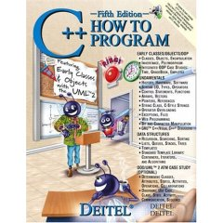
3. C++ Advanced Features Review: When can/should I use them?
Object, pointer, reference
Const, static, extern, type cast
Namespace
Constructor, destructor
#include, #define, #ifdef
Enum, union, bit slicing
Public, private, friend
Inheritance, virtual, polymorphism
Operator overload
Template
Functional object
Stream classes
String
Exception handling

Slide 44
3. C++ Advanced Features Review: When can/should I use them?
Understanding “variables”
  Object, pointer, reference
  Const, static, extern, type cast
  #define, typedef
  Namespace
Understanding “classes”
  Constructor, destructor
  Enum, union, bit slicing
  Public, private, friend

Slide 45
3. C++ Advanced Features Review: When can/should I use them?
Understanding “overloading”
  Function & operator overloading
  Function & class template
Understanding “polymorphism”
  Class inheritance, virtual function
  Functional object
Understanding “libraries”
  #include, #ifdef
  Stream classes
  String
Exception handling

Slide 46
Homework #2
Target due: Week #4 (10/06)
  A command line reader
  Thorough understanding of “pointers”
  Basic program design
  Ref code: 836/938 lines C++ (last year’s)
  New feature(s) may be added...

Slide 47
A short version of “Computer Programming” class?
NO!!
If you don’t have any background in C++ (or C) ...
  You probably have chosen the wrong class.
If you are poor in C++ programming...
  Well, you are definitely NOT the only one, so you are very welcome!!
  Please pay attention to the lectures in this topic, and make sure you can commit enough time on homework

Slide 48
You may think I cover way too many details in C++... (Why bother to understand them?)
Remember:
Programming is a computer science.
  There is NO random bug!!
  Everything happens for a reason.
  You need to be rationale, and be “precise on the details”.
  ➔ Capability to handle the complexity!!
But...
Programming is also an art.
  A good program looks beautiful!!
  A beautiful program is beautiful for a reason.
  A good design is a MUST, and easy to maintain to make the program live long!
  ➔ Sense to manage the complexity!!

Slide 49
Homework #3
Target due: 10/20
  Complete command interface and a simple command-line number converter.
  Learn how to write a structured code
  Homework description file: 16 pages
  Ref code: 1789(2114)/2409 lines C++

Slide 50
Course Outline
Part 2: Polishing Your Programming Skills
C++ Advanced Features Review:
  When can/should I use them?
Memory Management:
  How to gain 30% performance improvement
  easily
STL Basics:
  The Standard Template Libraries
What is a Good Program?
  Software engineering point of view

Slide 51
4. Memory Management: How to gain 30% performance improvement easily
Where’s your bug?
  Segmentation fault, bus error, etc
Constructor and destructor
Fragmentation
System memory allocation/deletion
Implement your own memory manager
Garbage collection
Cache effect

Slide 52
Homework #4
Target due: 11/03
  Memory management
  Pointers (again), basic data structure
  Ref code: 1387(2643)/2865 lines C++

Slide 53
5. STL Basics:
The Standard Template Libraries
Why template libraries?
Why standard?
The standard template libraries
  Container classes
    List, array, map, hash, stack, string, bitvector, etc…
  Iterators
    Forward, bidirectional, random, etc
  Algorithms
    For_each, sort, partial_sum, sort, etc.
  Functional object
    Unary, binary, arithmetic, etc
  Utility
  Memory allocation

Slide 54
6. What is a Good Program? software engineering point of view
What do you suffer most in programming?
  Coding? Compiling? Debugging?
Which one is more important?
  Best or complete algorithm?
  Least instructions/sub-routines called?
  Least memory used?
  Smaller size of code?
  More (or less) advanced language features?
  Easier to debug and maintain?
  Nicely documented?
  Easily reusable?
Coding style guideline

Slide 55
7. Computational Complexity: Time and space tradeoffs
Review of complexity analysis
Why should I care?
What’s the most frequently encountered problem?
What’s your best bet?

Slide 56
Overview of this course
Part 1: Introduction
Part 2: Polishing Your Programming Skills
Part 3: Data Structure Revisited
Part 4: Putting What You Learn Together

Slide 57


8. Dynamic Array vs. Linked List: Which one is better?
Linear data types
Static vs. dynamic array
Why dynamic array? Why not linked list?
How to evaluate their performance?
  Runtime vs. memory usage
head
tail

Slide 58
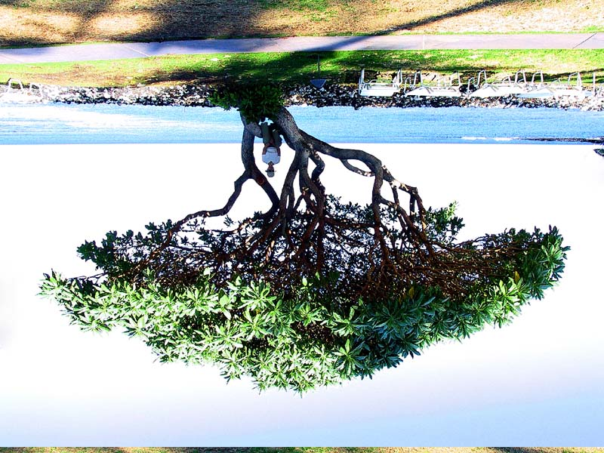
9. Tree: How to search data faster than linear time?
Non-linear data types
Decision trees
Tree traversal
Balanced trees
Implementation issues
a
b
c
d
e
f
g
h
i
j
k
l

Slide 59
Homework #5
Target due: 11/17
Implementation and comparison of various data structures
  Linked list
  Dynamic array
  Binary search tree
Ref code: 1418(2674)/3104 lines in C++

Slide 60
10. Graph and Circuit:
From CS to EE applications
Tree vs. graph
Basic graph theories
Graph traversal problems
Loop handling
How to design data structure for a circuit netlist?
C
C
g
c
d
g
c
d
e
e
A
D
A
D
a
b
f
a
b
f
B
B

Slide 61
Homework #6
Target due: 12/01
A circuit parser
  I/O and file streams
  Graph/Circuit data structure
  Hash/Map usage
  Boolean logic
Ref code: 1480(2736)/3803 lines in C++
A special lecture note on “Lex and Yacc” may be offered

Slide 62
11. Heap, Set and Map: How to store sorted data?
Review of sorting algorithms
Review of binary (balanced) trees
Complexity analysis
Alternative ways of implementation
Standard Template Library (STL) revisit

Slide 63
12. Cache vs. hash: Virtual memory in your program
Review on hash
Alternative to hash
What’s the difference?
Computational cache/hash
h(x)
a
b
Bryant, 60
c
Charlie, 90
Chris, 78
d
Denny, 80
w
x
y
z

Slide 64
Homework #7
Target due: 12/15
Implementation and practical applications of various data structures
  Heap
  Hash
  Cache
Ref code: 1381(2637)/2808 lines in C++
New requirements will be added this year…

Slide 65
13. Bit Vector and Matrix: All about numerical operations
Bitwise operations
Beyond 32/64 bits
Multi-valued system
Dense vs. sparse matrix
Matrix operations
Linear algebra…

Slide 66
Overview of this course
Part 1: Introduction
Part 2: Polishing Your Programming Skills
Part 3: Data Structure Revisited
Part 4: Putting What You Learn Together

Slide 67
Final Project
Functionally Reduced And-Inverter Graph (FRAIG)
  Read in a circuit netlist (HW6)
  Perform circuit optimization (graph operations)
  Simulate the circuit (graph traversal, Boolean operations)
  Collect functionally equivalent candidate pairs (efficient hash implementation)
  Define the “magic number” to control the program flow (engineering sense)
Ref code: 4572(5828)/8063 lines in C++
30% of the final grade!! Please start earlier!!

Slide 68
Overview of this course
Part 1: Introduction
Part 2: Polishing Your Programming Skills
Part 3: Data Structure Revisited
Part 4: Putting What You Learn Together

Slide 69
Class Schedule
09/16 | Intro, DS in Prog., Linux
09/23 | Linux Prog., C++ Review | HW2 out
09/30 | C++ Review (variables)
10/07 | C++ Review (class, polymorphism) | HW3 out | HW2 due
10/14 | C++ Review (polymorphism, I/O)
10/21 | Mem Mgr | HW4 out | HW3 due
10/28 | STL,Good Prog., Complexity
11/04 | Array and List, Tree | HW5 out | HW4 due
11/11 | Tree

Slide 70
Class Schedule
11/18 | Graph | HW6 out | HW5 due
11/25 | Heap, set, Map
12/02 | Cache and Hash | HW7 out | HW6 due
12/09 | Final Project Discussion
12/16 | Final Project Discussion | Proj. out | HW7 due
12/23 | Final Project Discussion
12/30 | Special Topic
01/06 | Special Topic
01/13 | Final exam week
01/20 | Final project week |  | Proj. due

Slide 71
Homework Assignments and Final Project
Once again, get yourself familiar with the C++ programming on Linux ASAP!!
  You MUST compile your code on Linux or OS X environment.
Homework turn-in
  Through NTU Ceiba class website
  Please pay attention to the rules on the class website
  Filenames, compression rules, etc.
No copying/pirating
  If happens, -20 for your term grade!!
Don’t miss any homework!!
  ~10% of your term grade...
Do not delay
  1 day → - 1/3
  2 days → - 2/3
  3 days and up → 0

